Slide 1
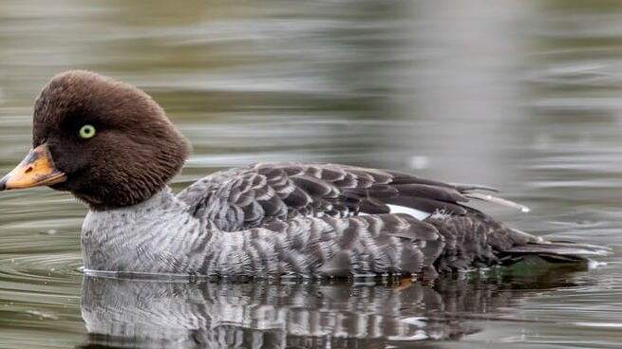
Duck Identifier App
Liam Dyer & Marcus Pickett

Slide 2
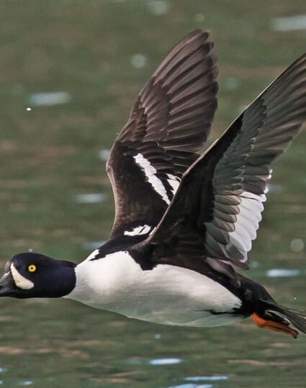
Introduction
An IOS app that can identify Newfoundland's wild ducks
A built in GPS with a waypoint pin system
A database of Newfoundland’s duck species information and guides.

Slide 3
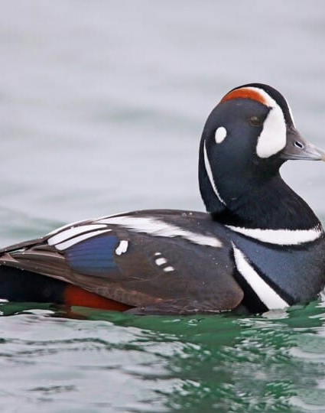
The problem
Being a duck Hunter, you must:
Keep track of where you are travelling and how to return safely
Remember the best hunting locations
Identify the duck/ducks
Know the weather

Slide 4
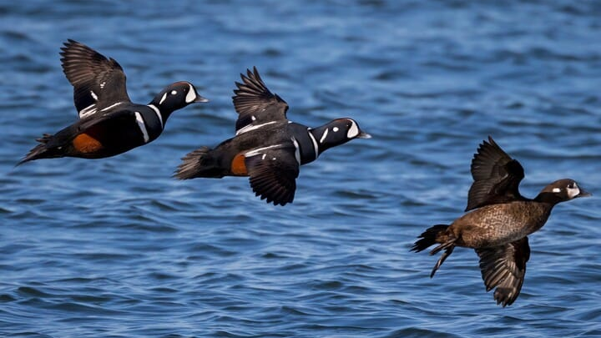
Methodology
App creation on IOS
Create a database of ducks and the information about each species
Teaching a ML vision model to identify pictures taken of ducks
Implementing a GPS API with integrated pin-points to track hunting locations
Implementing a weather API

Slide 5
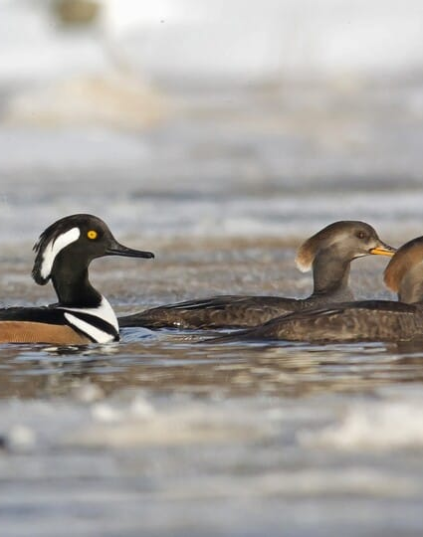
Courses
Databases
Software Engineering
iPhone Application Development
Computer Graphics and Game Development
Project Management & Financial Analysis

Slide 6
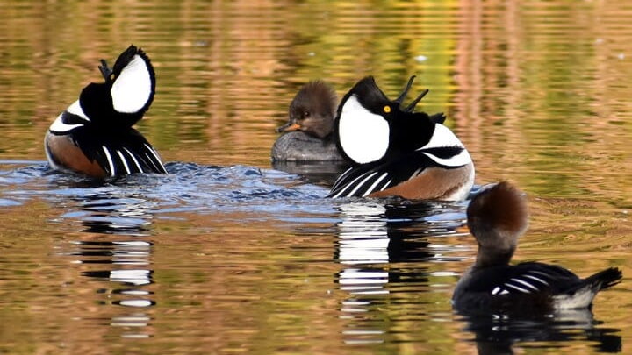
Secondary Research
Only one similar app Ducks Unlimited that has a 2/5-star rating with no support or info on Canadian duck hunting.
APIs for beginners by YouTube channel freeCodeCamp.org
How to Make an App in 8 Days (2025 Full Tutorial) by YouTube channel CodeWithChris

Slide 7
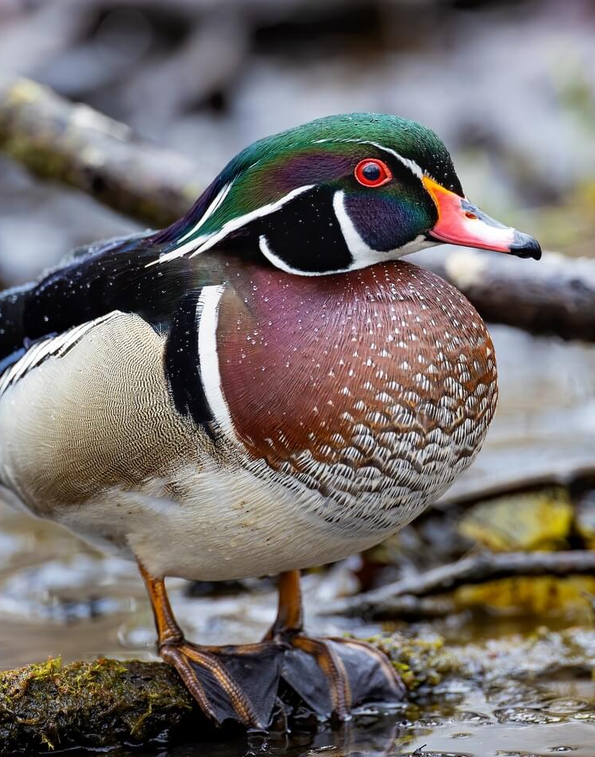
Hypothesis
The goals that need to be met to succeed:
Keep on track with the Gantt chart
Create and follow an agile development plan
Learn how to implement APIs using IOS app development

Slide 8
Gantt Chart

Slide 9
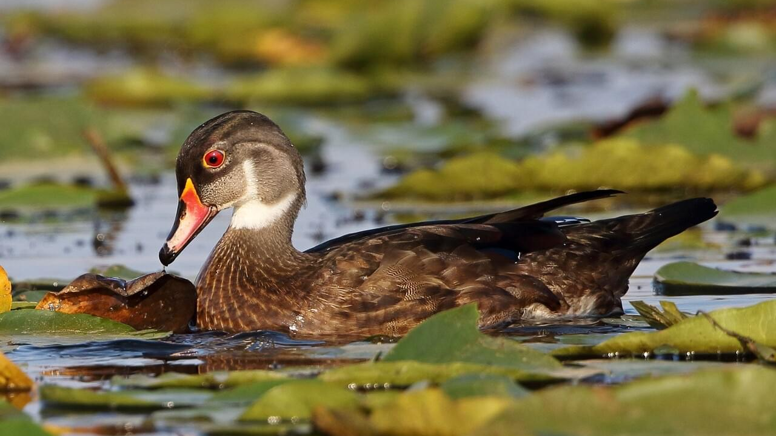
References
Cornell Lab of Ornithology. (n.d.). Barrow’s Goldeneye identification. All About Birds. https://www.allaboutbirds.org/guide/Barrows_Goldeneye/id
Cornell Lab of Ornithology. (n.d.). Harlequin Duck identification. All About Birds. https://www.allaboutbirds.org/guide/Harlequin_Duck/id
Cornell Lab of Ornithology. (n.d.). Hooded Merganser identification. All About Birds. https://www.allaboutbirds.org/guide/Hooded_Merganser/id
Cornell Lab of Ornithology. (n.d.). Wood Duck photo gallery. All About Birds. https://www.allaboutbirds.org/guide/Wood_Duck/photo-gallery
freeCodeCamp.org. (2019, December 16). APIs for beginners – How to use an API (Full course / tutorial) [Video]. YouTube. https://www.youtube.com/watch?v=WXsD0ZgxjRw
CodeWithChris. (2024, December 12). How to make an app in 8 days (2025 full tutorial) [Video]. YouTube. https://www.youtube.com/watch?v=uvLUJev1F20

